Slide 1


Department of Computer Science &Engineering Artificial
Intelligence & Machine Learning
A.P. Shah Institute of Technology
G. B. Road, Kasarvadavli, Thane(W), Mumbai-400615
UNIVERSITY OF MUMBAI
Academic Year 2024-2025

Slide 2

NUTRINO AI: A HYBRID RECOMMENDATION SYSTEM
BY
AAFREEN KHAN (22106048)
PRACHITI PARAB (22106028)
SNEHA GUPTA (22106046)
TULSI DUBEY (22106055)
PRPOJECT GUIDE
Prof. TARUNA SHARMA

Slide 3
Outline
Introduction
Literature survey of existing system
Limitation of existing system
Problem Statement
System Design
Framework/Algorithm
Technology Stack of proposed system
Details of Database/Input to the System
Implementation
Details of Database/Input to the System
Implementation
Implementation
Conclusion
References

Slide 4


Introduction
1
An AI-powered nutrition recommendation system that tailors diet plans based on user preferences, health goals, and dietary restrictions.
Utilizes a hybrid recommendation approach combining User Based filtering, content-based filtering, and knowledge-based techniques for accurate suggestions.
BMI calculator that takes user inputs to determine their BMI category. Based on this classification, it recommends customized meal plans and recipes
Adapts over time by learning from user interactions, food preferences, and health data.
2
3
4

Slide 5
Introduction
Key Features:
Hybrid recommendation system – Uses multiple AI techniques for better accuracy.(User based Collaborative filtering + Content Based Filtering)
Personalized meal planning – Suggests meals based on health metrics.
Nutrient tracking & analysis – Breaks down macros, calories, and micronutrients.
User preference learning – Adapts to likes/dislikes and dietary restrictions.
Benefits:
Accurate meal recommendations based on AI & user data, Better health outcomes through personalized nutrition, Efficient meal planning with automated suggestions.

Slide 6
Literature Survey of the existing system
Sr.No | Title and Year | Techniques used | Performance metrics | Suggestions
[1] | "Hybrid-Based Food Recommender System Utilizing KNN and SVD" (Zhi-Toung Yap, Su-Cheng Haw) 2024 | K-Nearest Neighbors (KNN), Singular Value Decomposition (SVD), Collaborative Filtering, Content-Based Filtering, Hybrid Approach | Accuracy, Precision, Recall, RMSE | Further improvement of hybrid models by integrating deep learning techniques
[2] | "Hybrid Recommender Systems: A Systematic Literature Review" (Erion C¸ano, Maurizio Morisio) 2017 | Analysis of hybrid recommendation techniques combining collaborative and content-based filtering | Not explicitly stated, but typically coverage, diversity, accuracy, and novelty | Need for standard benchmarking datasets, evaluation frameworks, and explainability in hybrid recommender systems
[3] | "A Hybrid Recommender System Based on User-Recommender Interaction" (Heng-Ru Zhang, Fan Min, Xu He, Yuan-Yuan Xu) 2015 | User-Recommender Interaction Model, Hybrid Filtering | MAE (Mean Absolute Error), RMSE (Root Mean Square Error) | Enhance interaction modeling for better personalized recommendations
[4] | "Hybrid Recommendation System for E-commerce Using Deep Learning and Collaborative Filtering" (Wang et al.) 2022 | Deep Neural Networks, Collaborative Filtering, Content-Based Filtering | F1-score, Precision, Recall, RMSE | Suggests integrating reinforcement learning for adaptive recommendations

Slide 7

Problem Statement
Traditional nutrition counseling is limited by high costs and Users face difficulties in finding personalized nutrition recommendations. Existing systems often lack the ability to fully integrate diverse data sources. Nutrino-AI aims to create a hybrid recommendation system that combines content-based and user based filtering to provide more accurate and personalized dietary advice.

Slide 8

Limitation of Existing System
1. Lack of Personalization
2. Limited Dietary Information
3. Inconsistent User Experience
4. Over Specialization

Slide 9
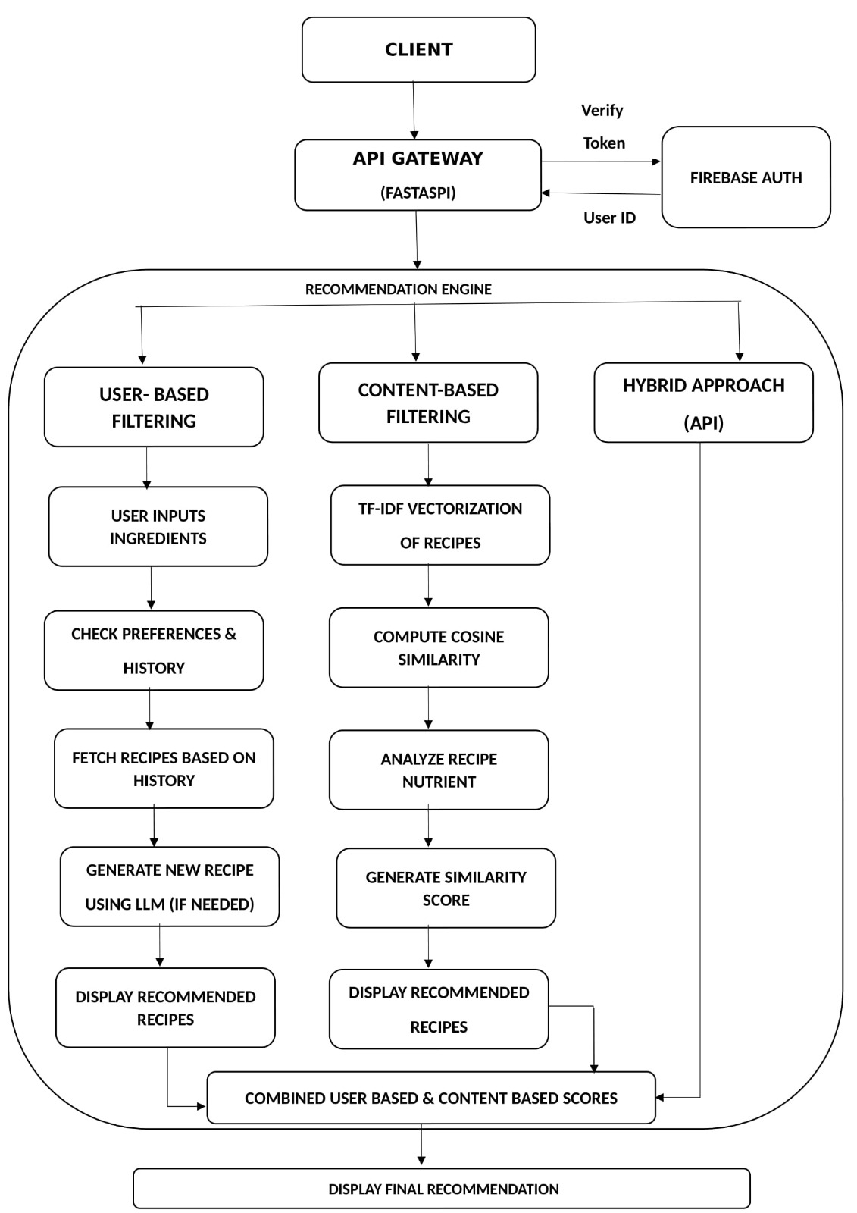
System Design

Slide 10





Technology Stack of proposed system
Frontend - React JS and CSS
Backend -Node JS and Python
Database - Firebase
Framework : FastAPI

Slide 11
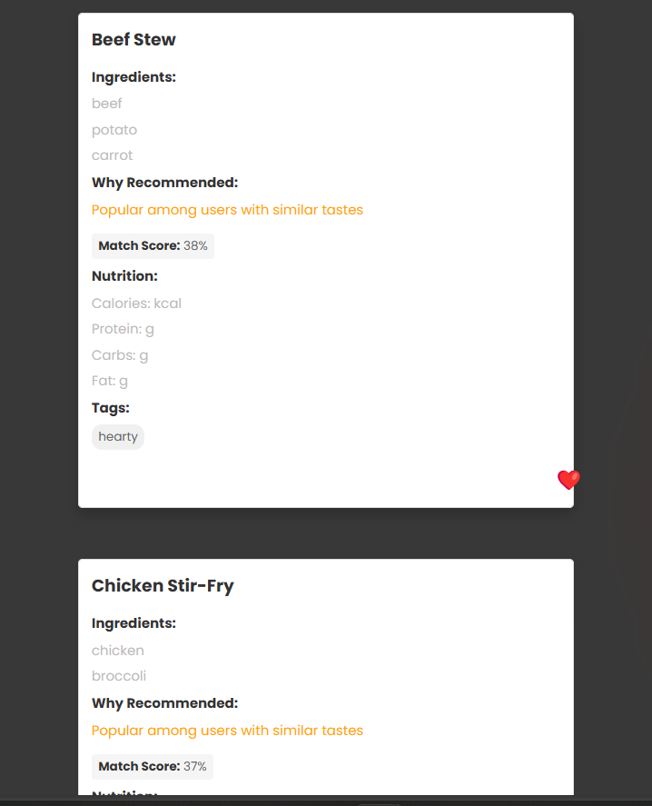
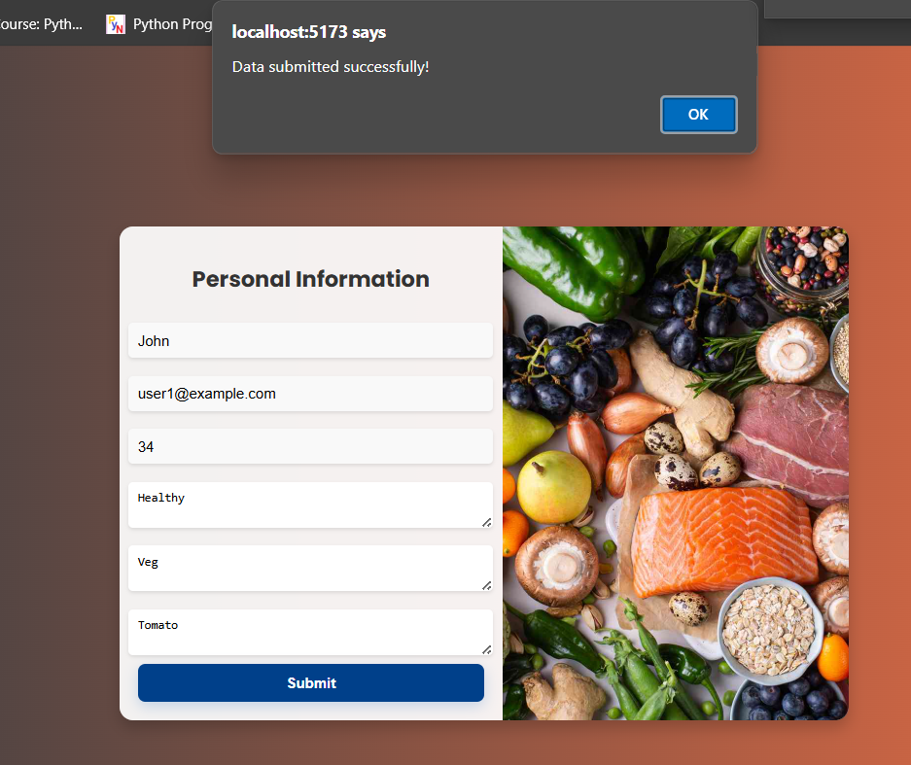
Implementation

Slide 12
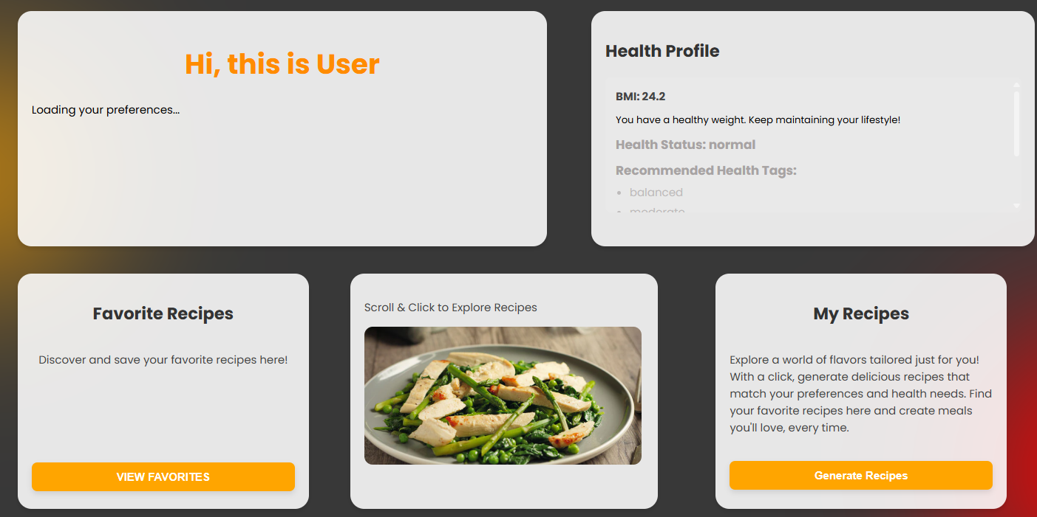
Implementation

Slide 13
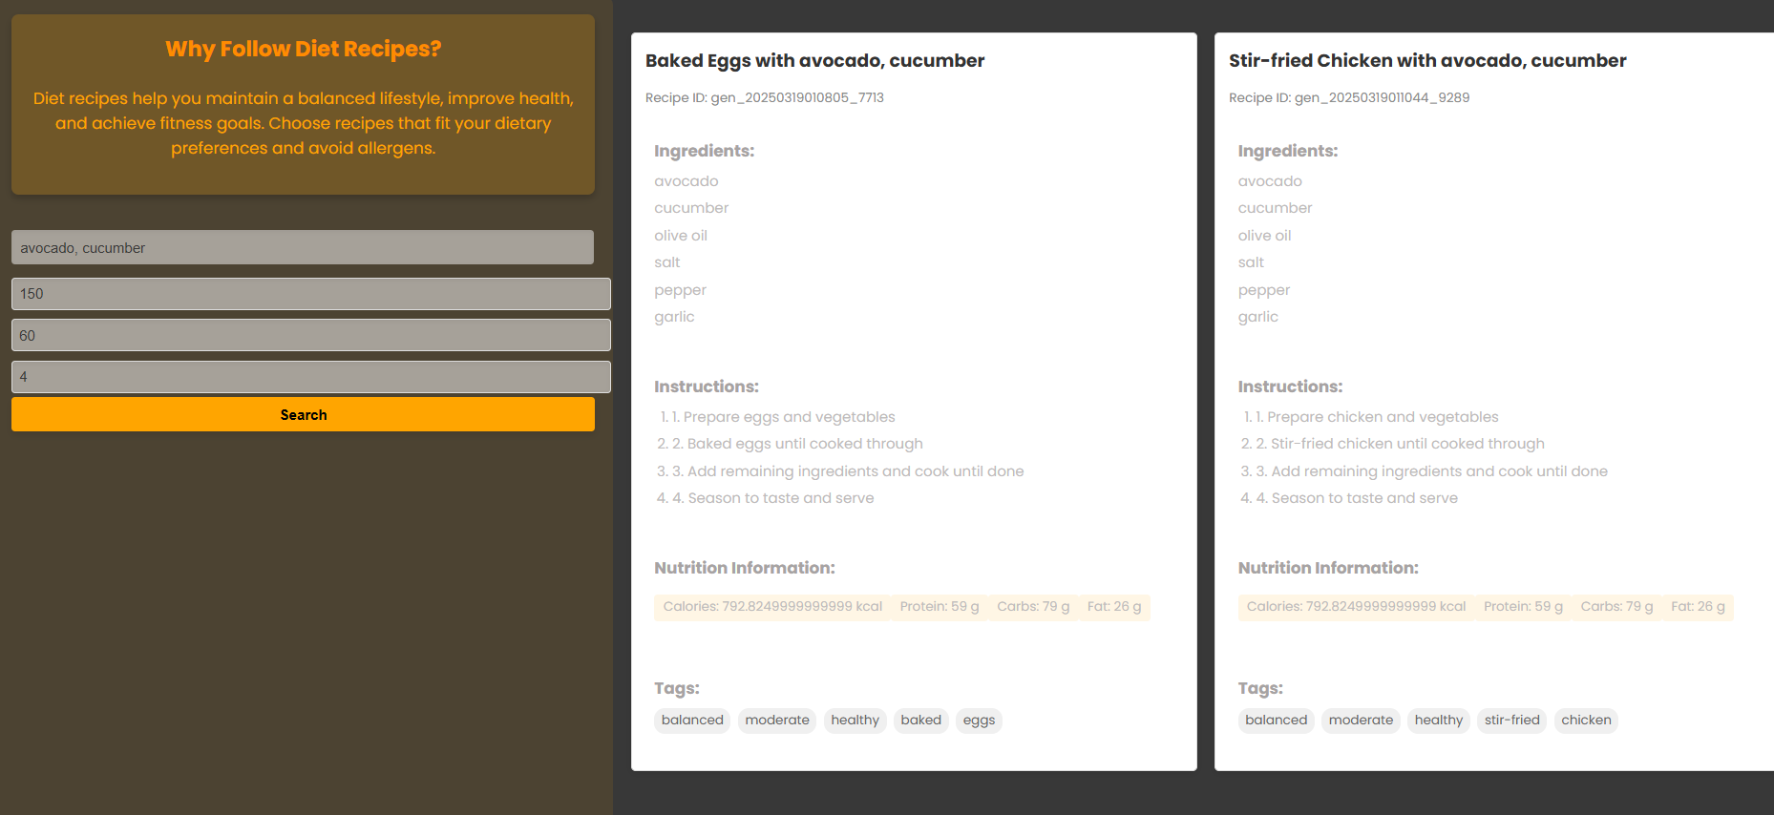
Implementation

Slide 14
Conclusion
Personalization: Offers tailored nutrition recommendations based on user preferences, health goals, and conditions.
Hybrid Approach: Combines content-based and User based filtering methods for improved accuracy and diversity.
Challenges: Faces limitations like data quality, scalability, real-time adjustments, and complexity in maintaining personalized advice.

Slide 15
REFERENCES
References
[1] "Hybrid-Based Food Recommender System Utilizing KNN and SVD" Zhi-Toung Yap, Su-Cheng Haw This study discusses the combination of various algorithms, including collaborative filtering, content-based filtering, and hybrid approaches, in the context of a food recommender system. It was published in the journal Cogent Engineering on December 3, 2024.
[2] Hybrid Recommender Systems: A Systematic Literature ReviewErion C¸ ano1, Maurizio Morisio in the journal Intelligent Data Analysis, Volume 21, Issue 6, in 2017, spanning pages 1487 to 1524
[3] "A Hybrid Recommender System Based on User-Recommender Interaction" was authored by Heng-Ru Zhang, Fan Min, Xu He, and Yuan-Yuan Xu. It was published in the journal Mathematical Problems in Engineering in 2015. The article spans pages 1 to 11.
[4]Wang et al. (2022). Hybrid Recommendation System for E-commerce Using Deep Learning and Collaborative Filtering. Journal of Artificial Intelligence Research

